Slide 1
S-02 Rework A Workaround to Fix SATA Power Cable Interference Issue on S031 RVP
NVL-S
Suggested Rework Document

Slide 2
S-02 Rework
A Workaround to Fix SATA Power Cable Interference Issue on S031 RVP
Change Log | 2025 WW28 : initial
Description | To fix SATA power cable interference issue on S031 RVP. There are 2 rework options in this document, either way is working.
Impact | Without this rework, SATA cable can not be plugged into the SATA power HDR.
Rework Involved | Mechanical cut out
SKUs | NVL-S S031
Contacts | Lin, Nick1
HSD Link | N/A
Collateral Link | N/A
SW Dependency

Slide 3
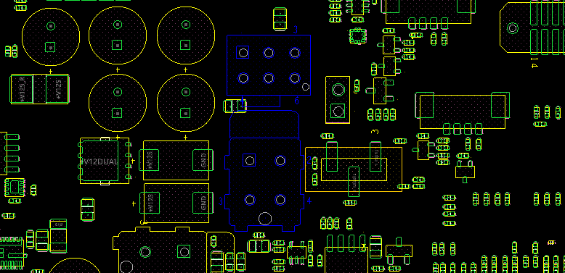
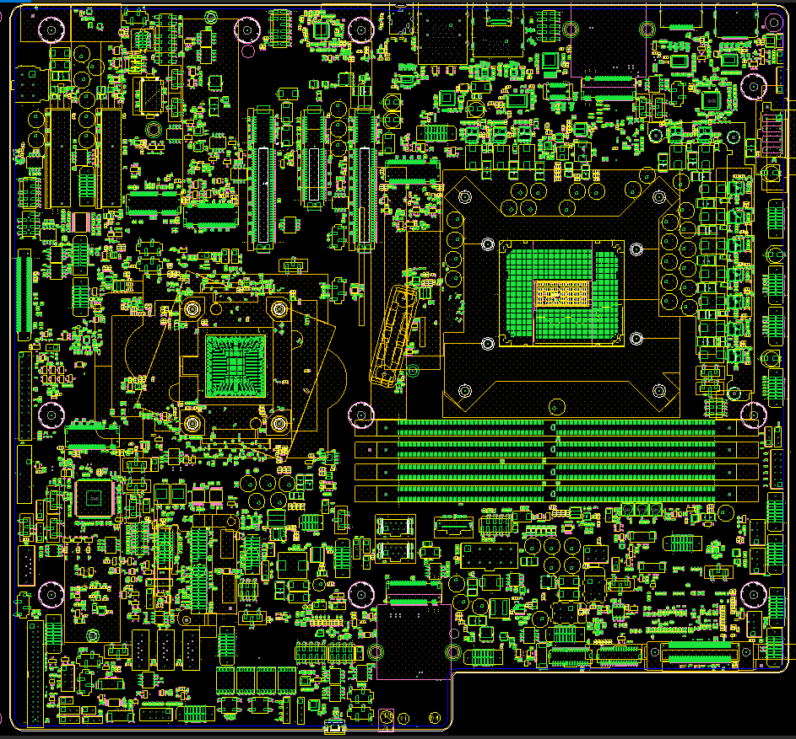
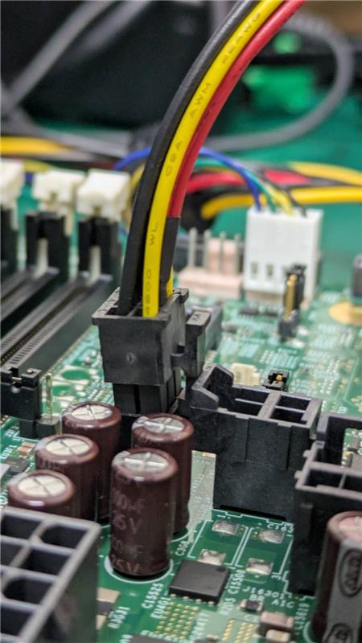
NVL-S S031
J24090
SATA Cable Power HDR: J24090
USB3.2 FP AIC power HDR: J4G3
J4G3
TOP
Mechanical interference
between SATA power cable
and headers.
J24090
J4G3

Slide 4
Rework Option 1

Slide 5
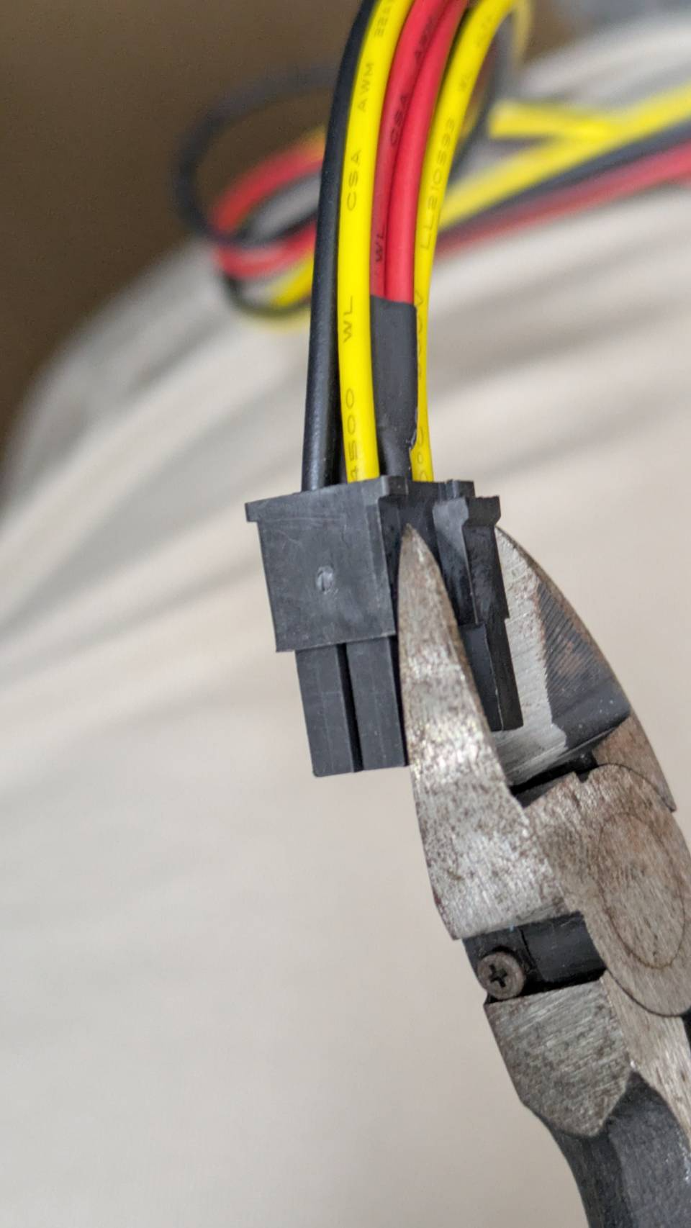
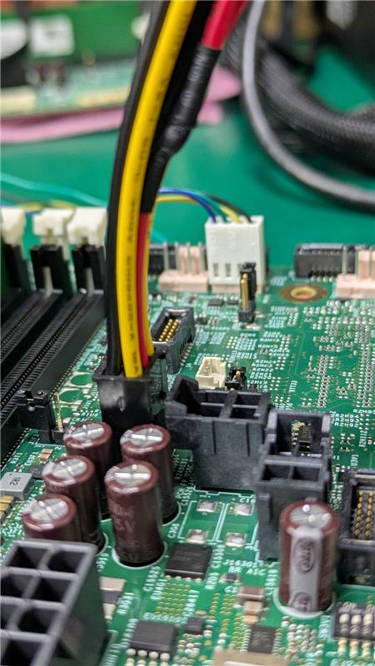
NVL-S S031
J24090
J4G3
Cable can not be plugged in completely.
Use pliers to cut the hook
on the cable.
After rework, it can
be plugged completely.

Slide 6
Rework Option 2

Slide 7
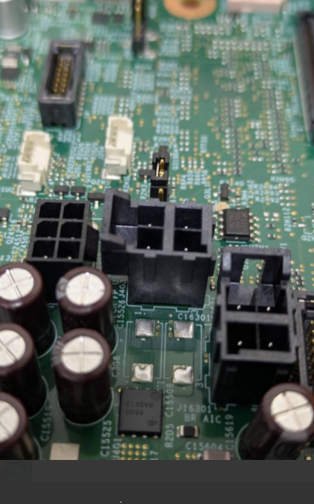
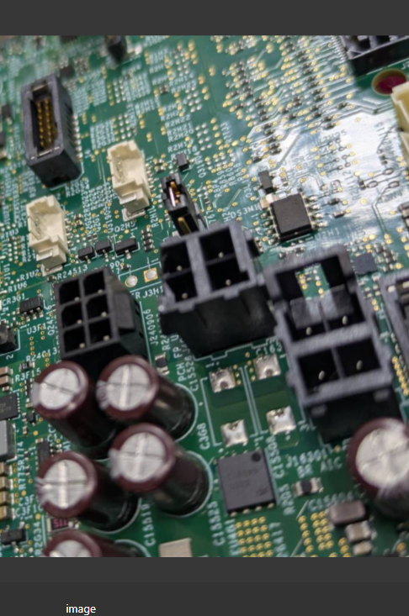
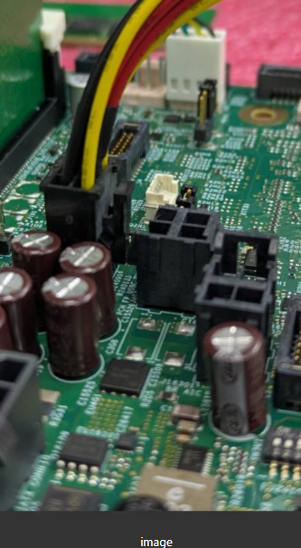
NVL-S S031
J24090
J4G3
Find J4G3 on board and cut the convex part of the HDR.
Use pliers to cut it like in the picture above
After the rework, it can
be plugged in completely.

